Slide 1
Pollution
____________________________________________________________________________________________
_______________________________________________________________________________________

Slide 2
Types of pollution
Air pollution
Noise pollution
Land pollution
Water pollution
Light pollution

Slide 3
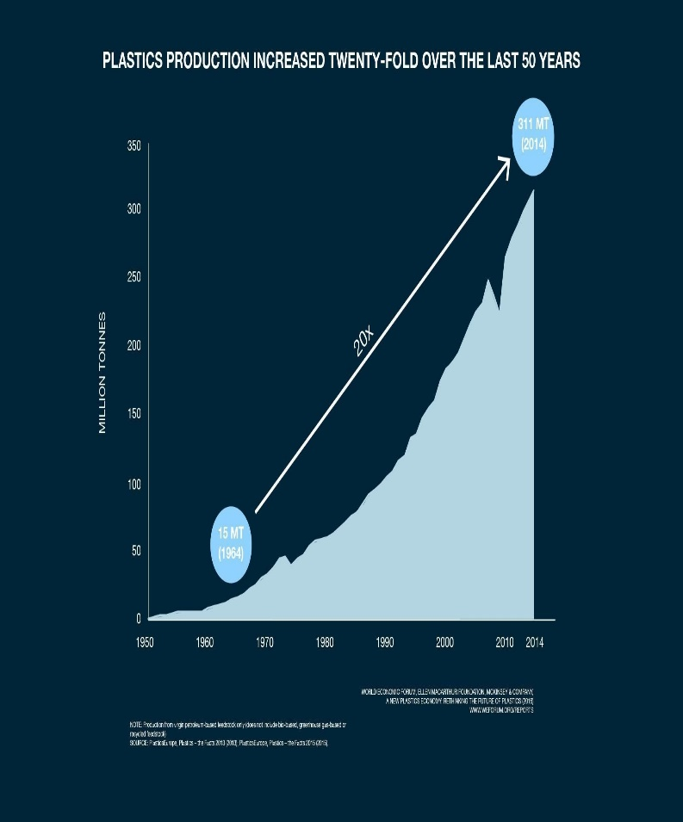
Air pollution
Air pollution is the contamination of air due to the presence of substances called pollutants in the atmosphere that are harmful to the health of humans and other living beings, or cause damage to the climate or to materials.^{[1]} It is also the contamination of the indoor or outdoor environment either by chemical, physical, or biological agents that alters the natural features of the atmosphere.^{[1]} There are many different types of air pollutants, such as gases (including ammonia, carbon monoxide, sulfur dioxide, nitrous oxides, methane and chlorofluorocarbons), particulates (both organic and inorganic), and biological molecules.

Slide 4
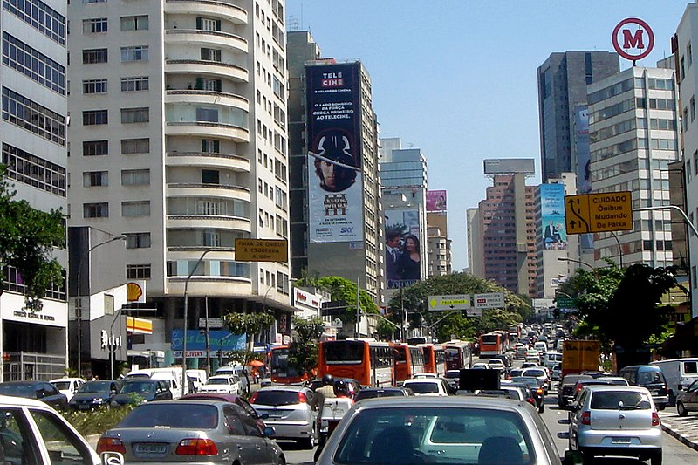
Noise pollution
Class | 1 | Group 2
Class 1 | 82 | 95
Class 2 | 76 | 88
Class 3 | 84 | 90
Noise pollution, or sound pollution, is the propagation of noise or sound with ranging impacts on the activity of human or animal life, most of which are harmful to a degree. The source of outdoor noise worldwide is mainly caused by machines, transport and propagation systems.^{[1][2][3]} Poor urban planning may give rise to noise disintegration or pollution, side-by-side industrial and residential buildings can result in noise pollution in the residential areas. Some of the main sources of noise in residential areas include loud music, transportation (traffic, rail, airplanes, etc.), lawn care maintenance, construction, electrical generators, wind turbines, explosions and people.

Slide 5
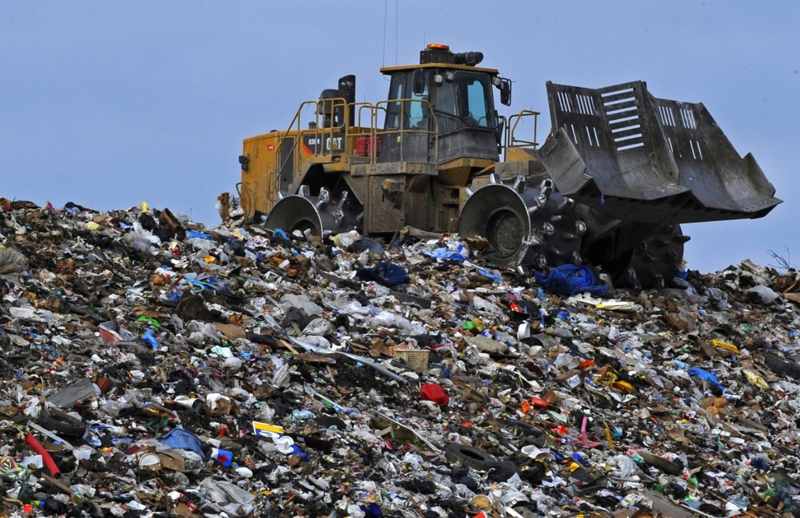
Land pollution
Soil contamination, soil pollution, or land pollution as a part of land degradation is caused by the presence of xenobiotic (human-made) chemicals or other alteration in the natural soil environment. It is typically caused by industrial activity, agricultural chemicals or improper disposal of waste. The most common chemicals involved are petroleum hydrocarbons, polynuclear aromatic hydrocarbons (such as naphthalene and benzo(a)pyrene), solvents, pesticides, lead, and other heavy metals. Contamination is correlated with the degree of industrialization and intensity of chemical substance. The concern over soil contamination stems primarily from health risks, from direct contact with the contaminated soil, vapour from the contaminants, or from secondary contamination of water supplies within and underlying the soil.^{[1]}

Slide 6
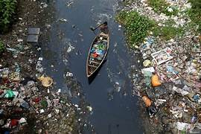
Water pollution
Water pollution (or aquatic pollution) is the contamination of water bodies, with a negative impact on their uses.^{[1]: 6} It is usually a result of human activities. Water bodies include lakes, rivers, oceans, aquifers, reservoirs and groundwater. Water pollution results when contaminants mix with these water bodies. Contaminants can come from one of four main sources. These are sewage discharges, industrial activities, agricultural activities, and urban runoff including stormwater.^{[2]} Water pollution may affect either surface water or groundwater. This form of pollution can lead to many problems. One is the degradation of aquatic ecosystems. Another is spreading water-borne diseases when people use polluted water for drinking or irrigation.

Slide 7
Light poltion
Most people can't imagine living without the modern convenience of electric lights. For the natural world, though, lights have changed the way that days and nights work. Some consequences of light pollution are:
Some birds sing at unnatural hours in the presence of artificial light.
Scientists have determined that long artificial days can affect migration schedules, as they allow for longer feeding times.
Streetlights can confuse newly hatched sea turtles that rely on starlight reflecting off the waves to guide them from the beach to the ocean. They often head in the wrong direction.
Light pollution, called sky glow, also makes it difficult for astronomers, both professional and amateur, to properly see the stars.
Plant's flowering and developmental patterns can be entirely disrupted by artificial light.

Slide 8
Other pollution facts:
Americans generate 30 billion foam cups, 220 million tires, and 1.8 billion disposable diapers every year, according to the Green Schools Alliance.
According to the WHO, ambient air pollution contributes to 6.7% of all deaths worldwide.
The Mississippi River drains the lands of nearly 40% of the continental United Sates. It also carries an estimated 1.5 million metric tons of nitrogen pollution into the Gulf of Mexico each year, resulting in a dead zone each summer about the size of New Jersey.
Pollution in China can change weather patterns in the United States. It takes just five days for the jet stream to carry heavy air pollution from China to the United States, where it stops clouds from producing rain and snow.
About 7 million premature deaths annually linked to air pollution, according to WHO. That is one in eight deaths worldwide.

Slide 9
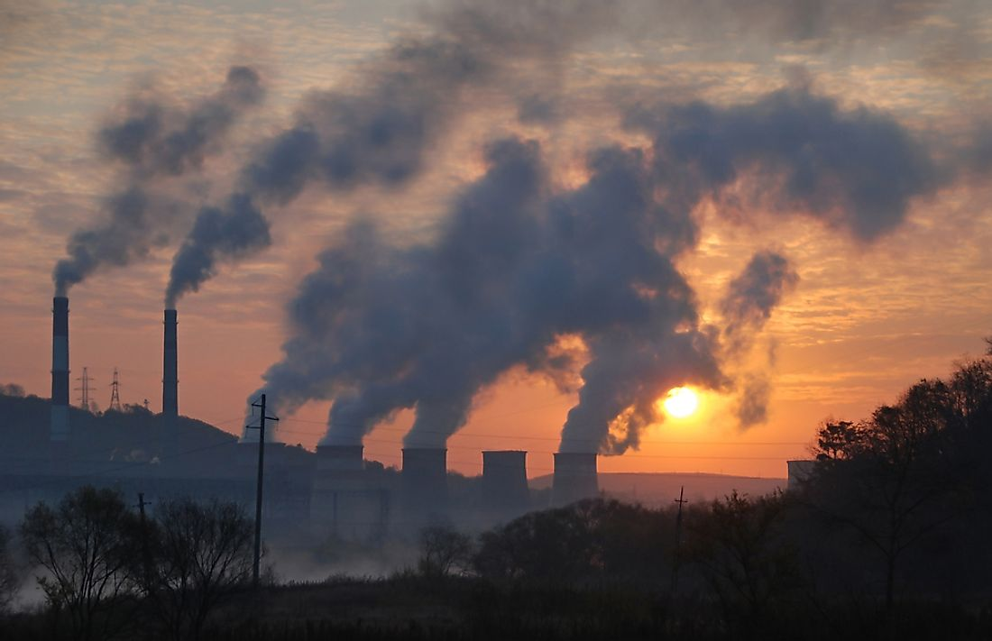
What Is Pollution What Is Pollution
Pollution is the act of introducing harmful substances to the environment that results in harming the natural surroundings. Substances that cause pollution are referred to as pollutants. These polluting substances are so diverse and they include chemical products, waste material, light, heat, and noise among others. Due to the diverse nature of pollutants in the world, there are various types of pollution such as water pollution, noise pollution, air pollution, soil contamination, radioactive pollution, and plastic pollution. While some pollution occurs through natural events such as volcanic eruptions and forest fires, most of the pollution in the world is caused by human activities.

Slide 10
Thank you(धन्यवाद)

